Slide 1
Segmenting Shopper Sessions
A Clustering Approach to E-Commerce Behavior
Brad Wicklund

Slide 2
Problem
Modern data science empowers retailers to turn customer data into predictive insights for smarter decisions in marketing and product development. Those who fail to leverage this data risk falling behind competitors.

Slide 3
Solution
We aim to segment online apparel shoppers using clickstream and product data to uncover distinct customer groups for targeted marketing.

Slide 4
Dataset
Dataset sourced from the UC Irvine Machine Learning Repository. This dataset comprises clickstream data pertaining to an online retailer based in Poland that specializes in maternity attire.
https://archive.ics.uci.edu/dataset/553/clickstream+data+for+online+shopping

Slide 5
Data Wrangling

Slide 6
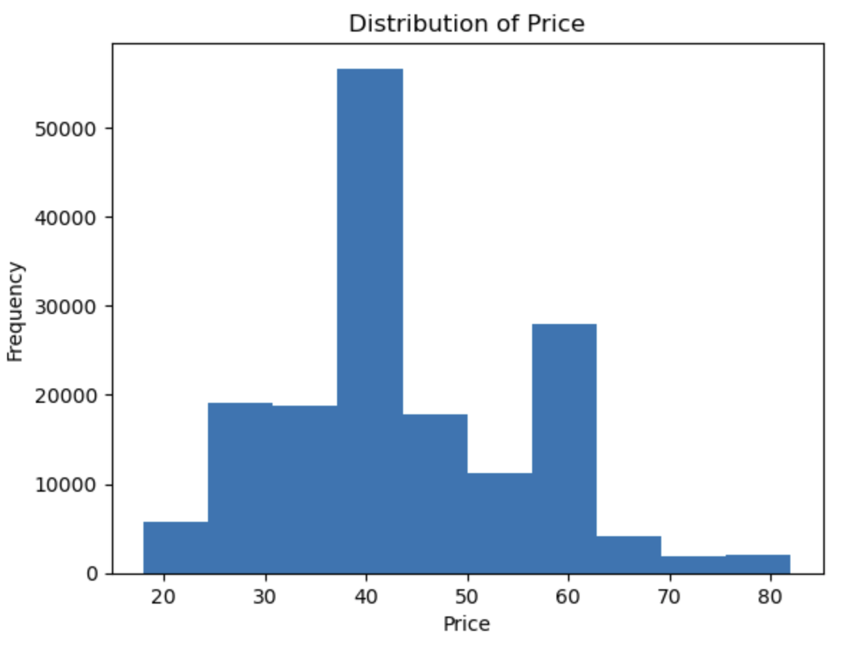

Slide 7
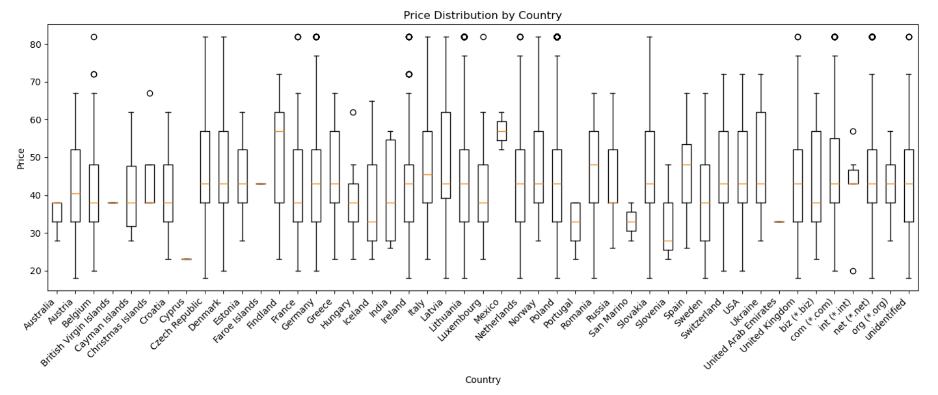

Slide 8
Exploring the Data

Slide 9
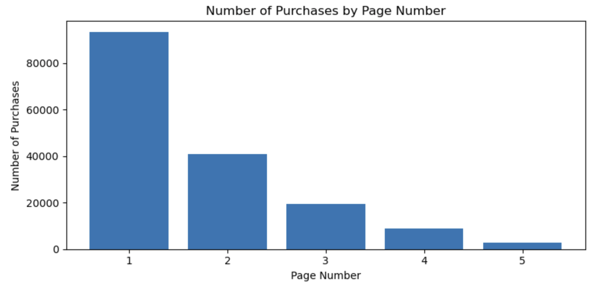

Slide 10
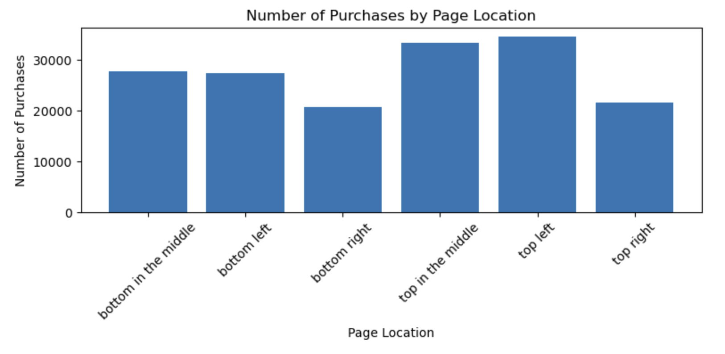

Slide 11
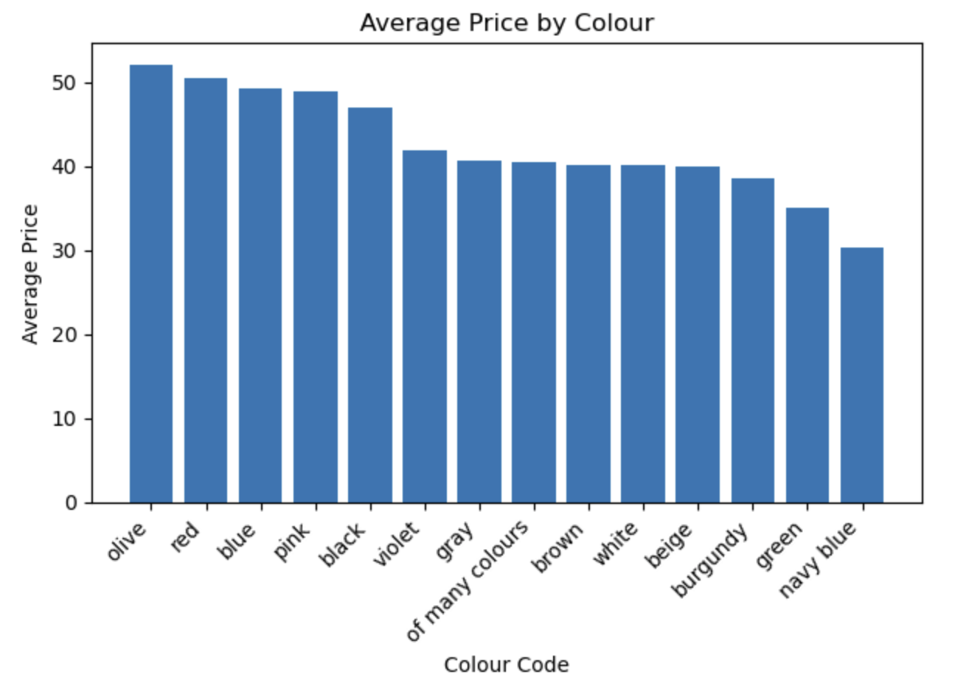

Slide 12
Modeling

Slide 13
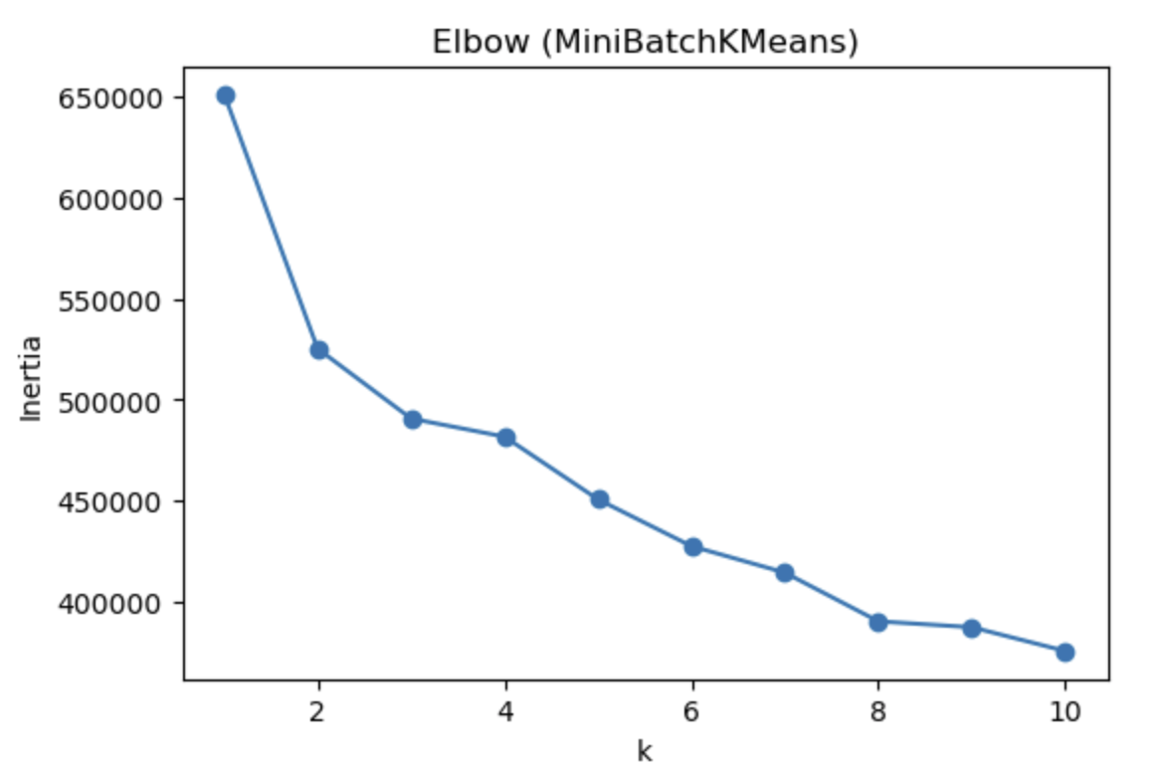
K-Means

Slide 14
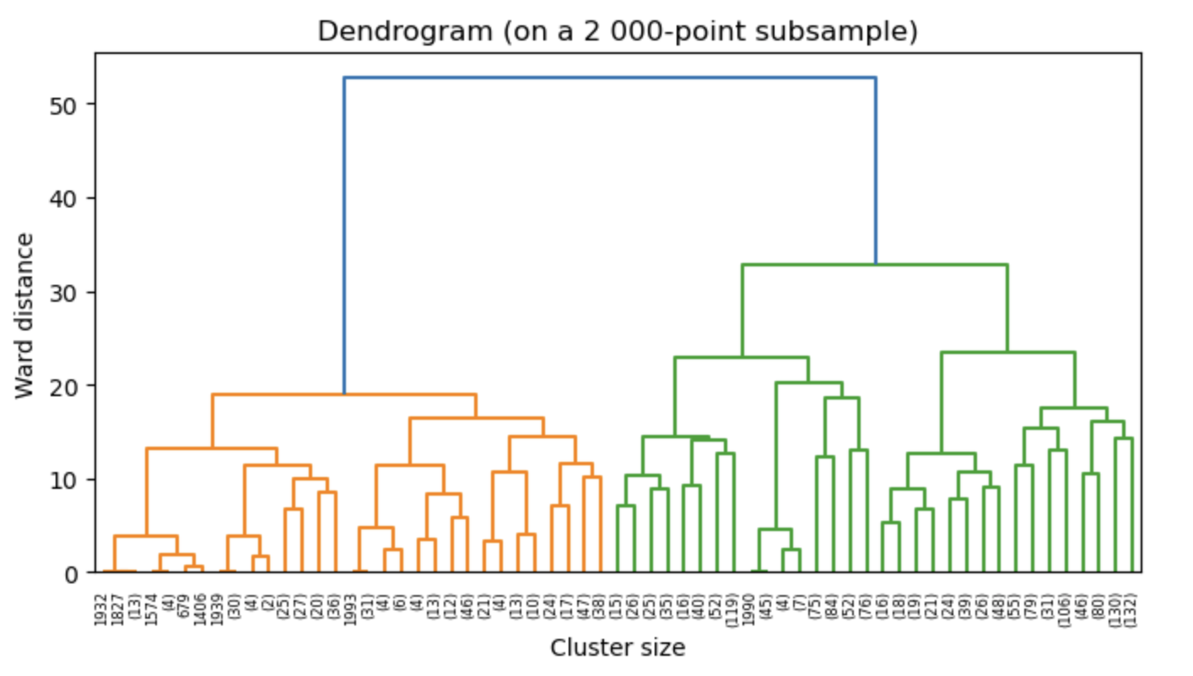
Hierarchical Clustering

Slide 15
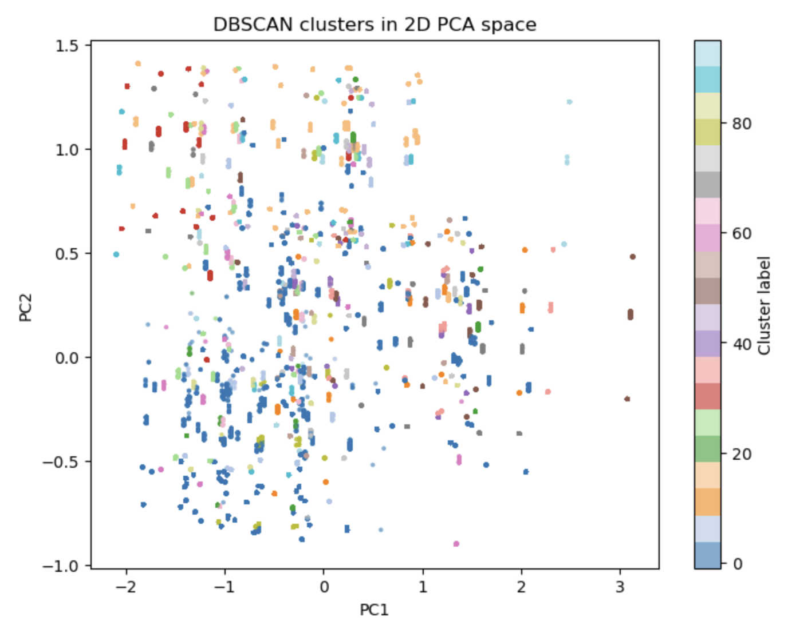
DBSCAN

Slide 16
Conclusions and Next Steps
None of the models tested provide cohesive enough clusters for future marketing purposes without further tuning.
Further analysis on page placement in a different project could help to provide useful insights regarding driving sales of a particular item.
Analysis of purchasing trends based on color could also be a beneficial exploration to influence future product development.

Slide 17
Q & A

